Slide 1

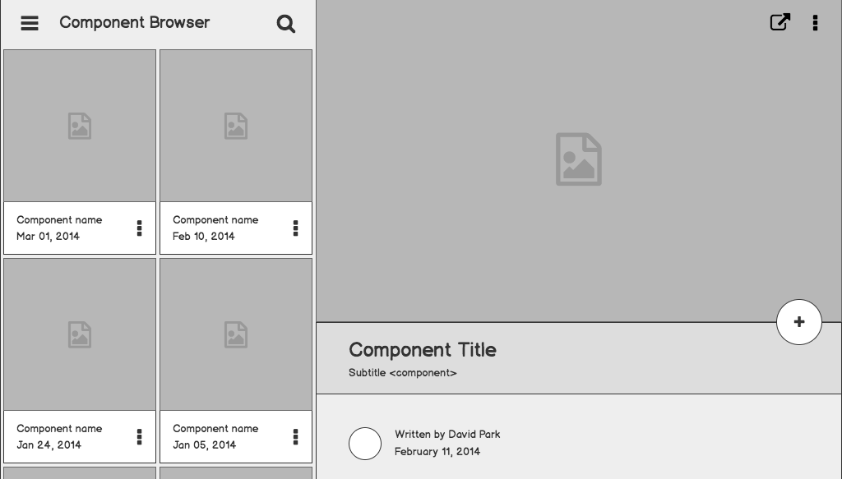

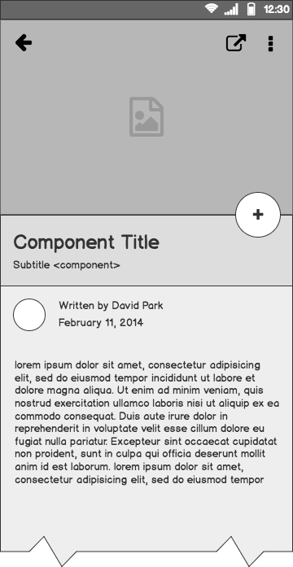
CYBERTRUST
CYBR 4580 - 8950 capstone project
https://cornsec.pw/

Slide 2
Outline
Project Summary
Risk List
Project Methodology
Site Mockups
Framework
Sprint Plan

Slide 3
Project Summary
We will supplement the current web application by adding additional user and admin tools:
Segment the user base into Administrative and User groups to allow separated functionalities.
Provide an administrator screen which fill provide a consolidated toolset for creating reports.
Create a user statistics screen to display analytics relating to individual usage.

Slide 4
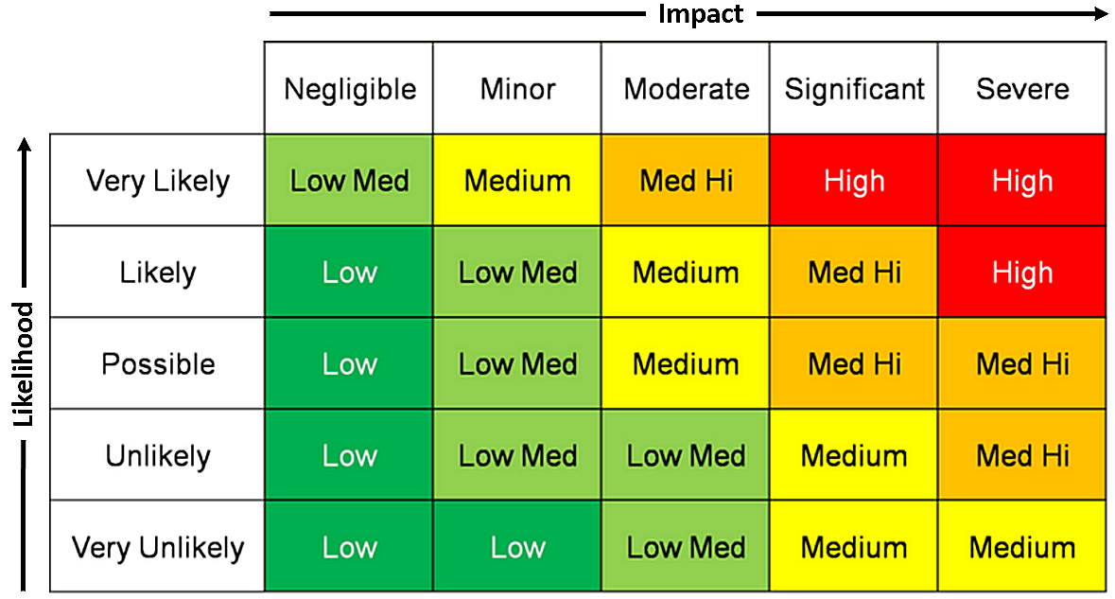
Project Risks
Risks Identified within project
Meeting / Scheduling conflict
Project Member leaves or reassigned
Unable to learn EmberJS
Failure to Complete Tasks in Scheduled Time
Design is infeasible
UI is bad quality

Slide 5
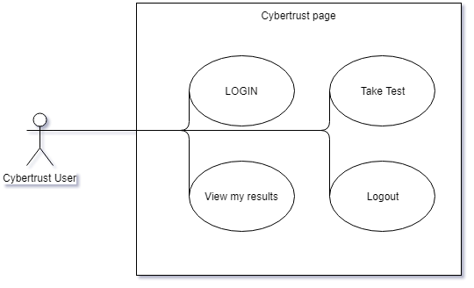
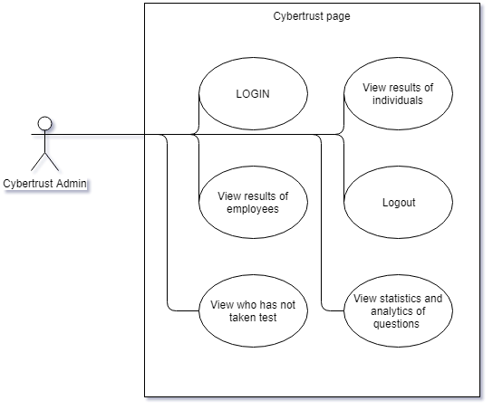
Project Methodology
Establish user and admin accounts within the existing cybertrust infrastructure.

Slide 6
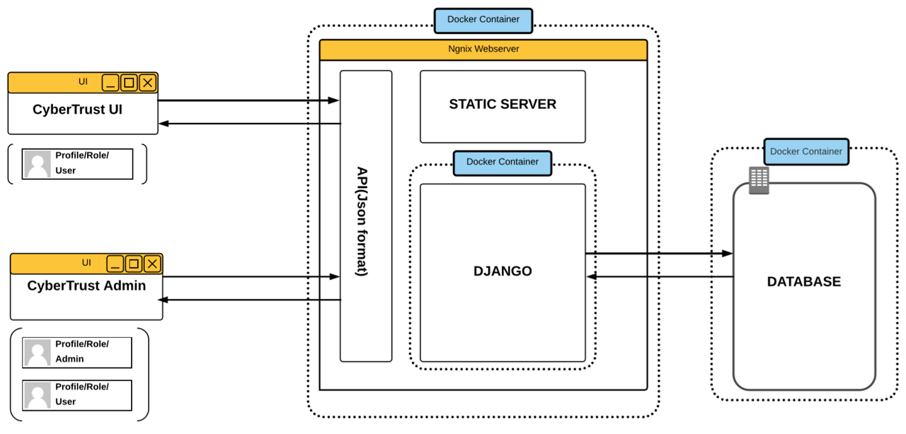
Site Mockups
Infrastructure already exists!
We will expand on this infrastructure by providing additional front end components and ensuring the backend can handle the new inputs with additional API’s

Slide 7
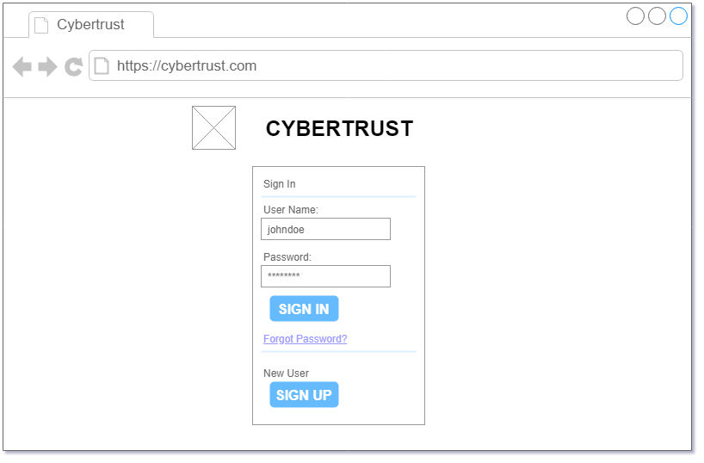
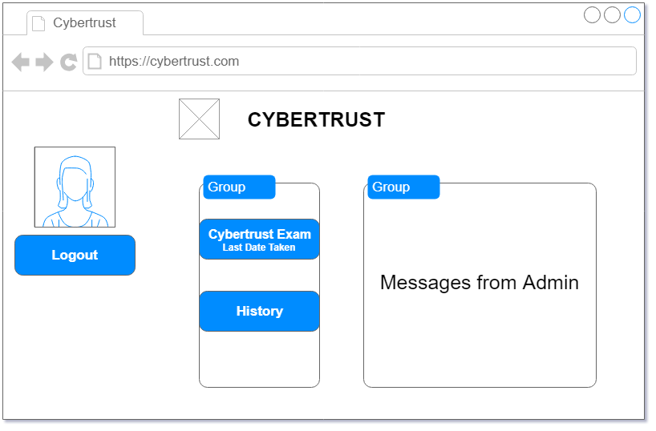
Site Mockups
Infrastructure already exists!
We will expand on this infrastructure by providing additional front end components and ensuring the backend can handle the new inputs with additional API’s

Slide 8
Project Framework
Ember.js
Django
Python
PostgreSQL
The team will utilize various tools within this project.

Slide 9
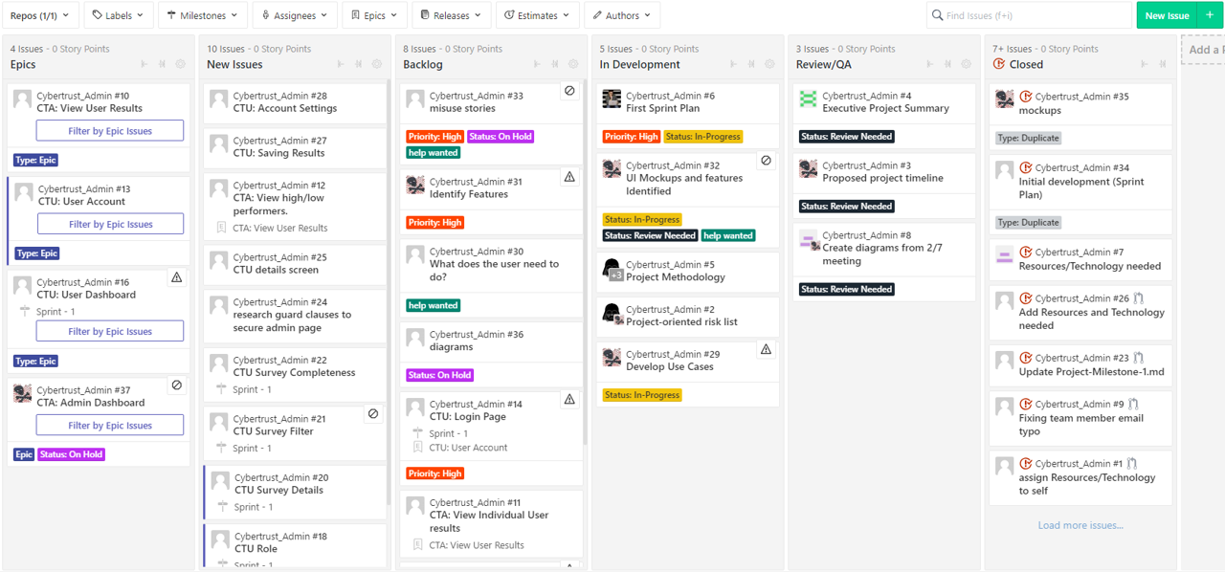
Sprint Plan

Slide 10
Assumptions
We assume that the established framework will not be affected by new additions
We assume that the current login and signup pages can be adopted into this project
We assume the dashboard will be able to call the current api and make use of the information
We assume the testing server will be available to all members of the team

Slide 11
Questions?

